Slide 1
Female fashion vs. male fashion
By angela kunanbaeva

Slide 2
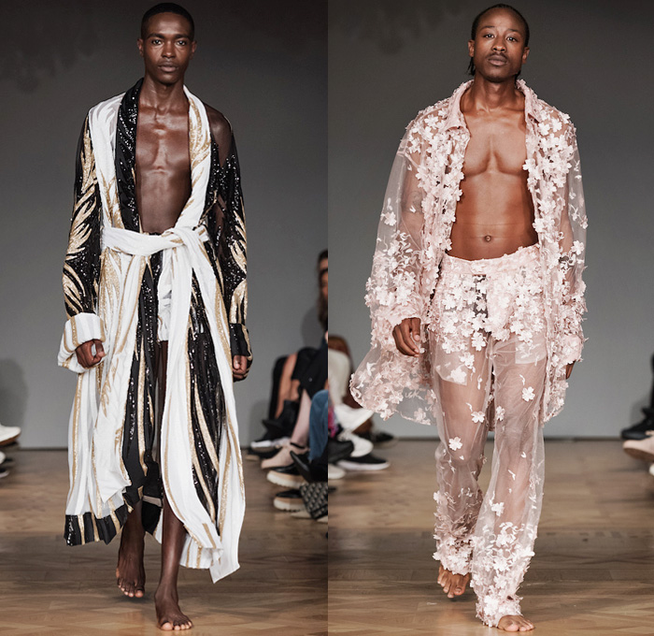
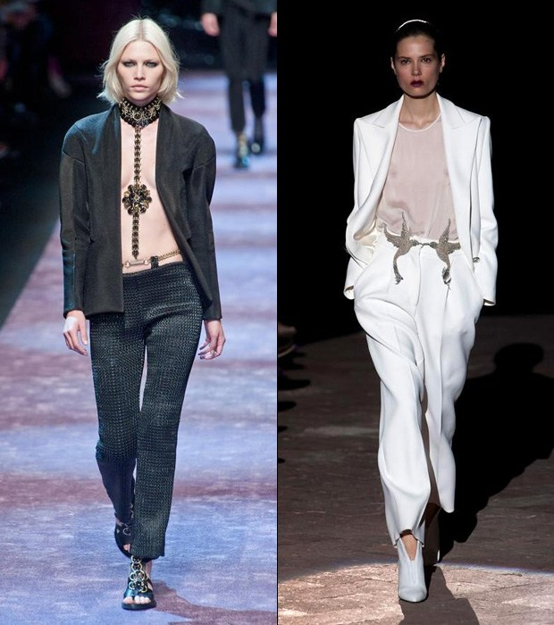
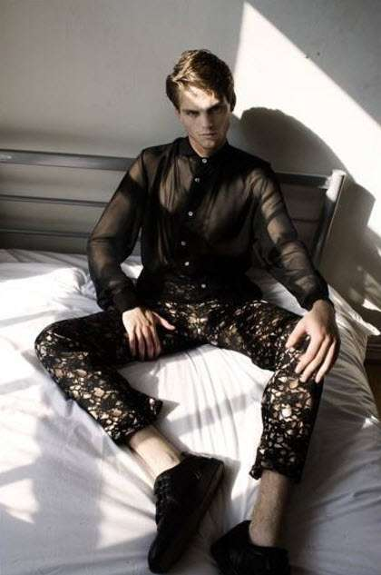
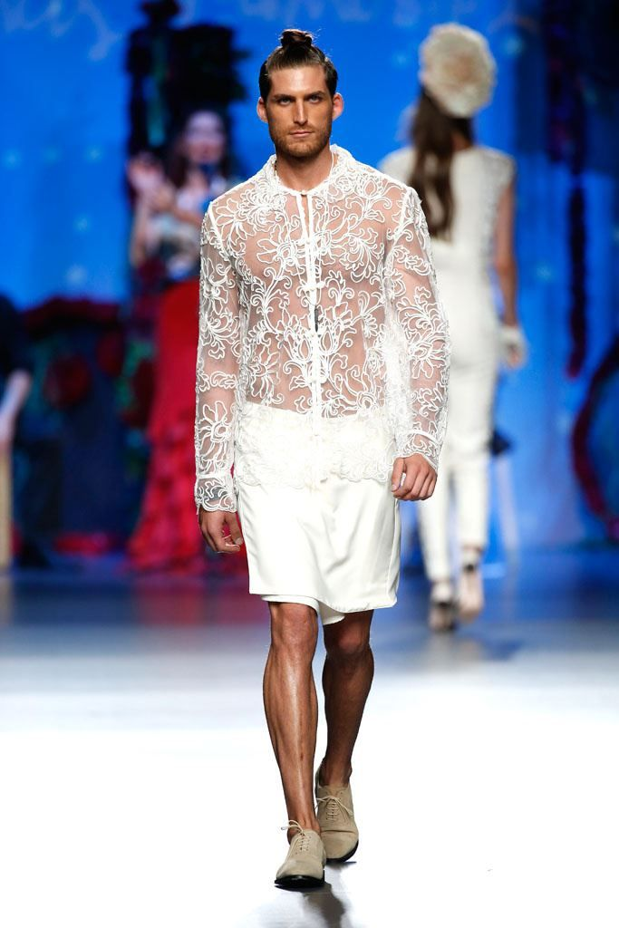
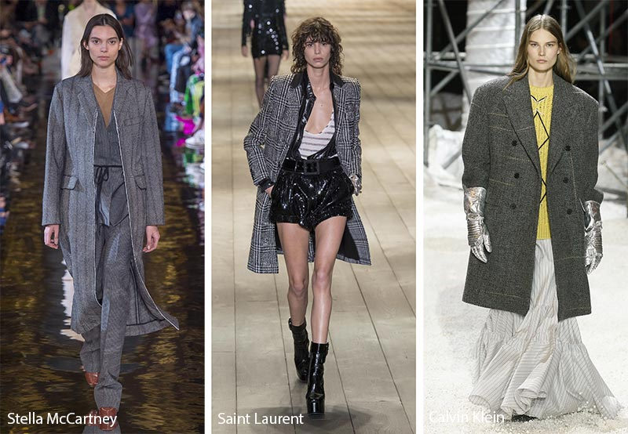
Why fashion?

Slide 3
Model analysis
Exclusion of words
Gender related
Stop words
Performs better without
Word combination
1 and 2

Slide 4
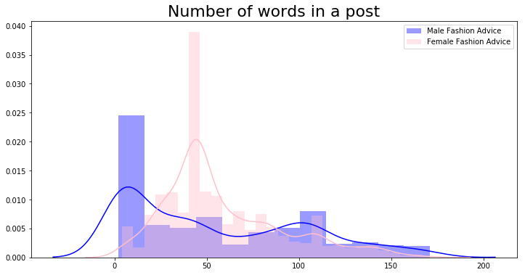

Slide 5
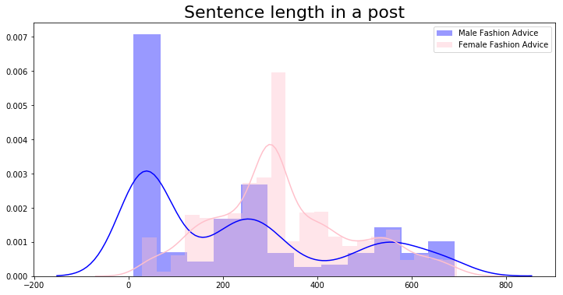

Slide 6
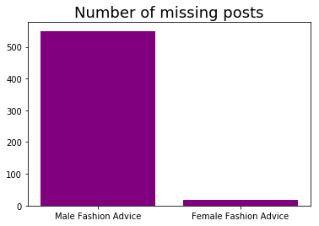
Male Fashion Advice
2,2 mln
Female Fashion Advice
850k

Slide 7
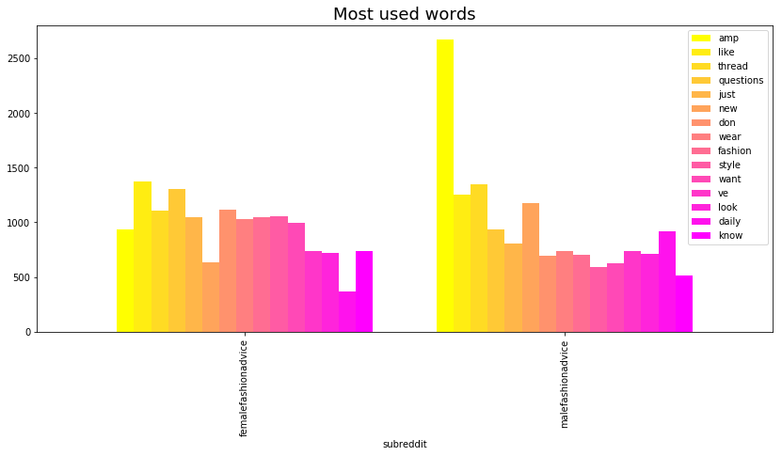

Slide 8
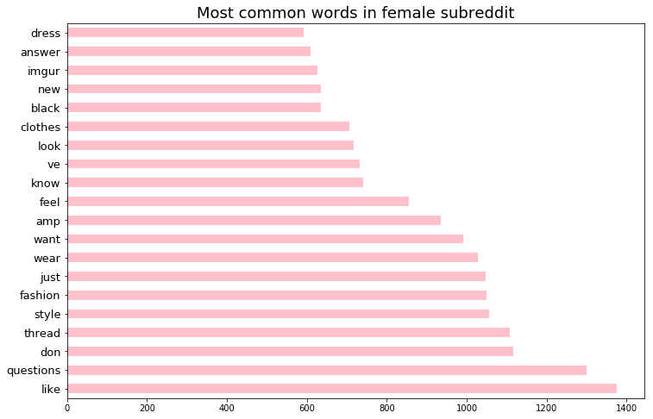

Slide 9
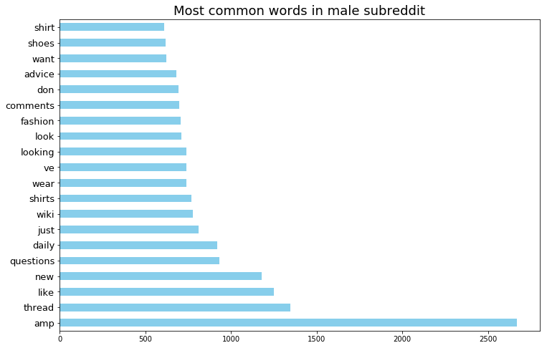

Slide 10
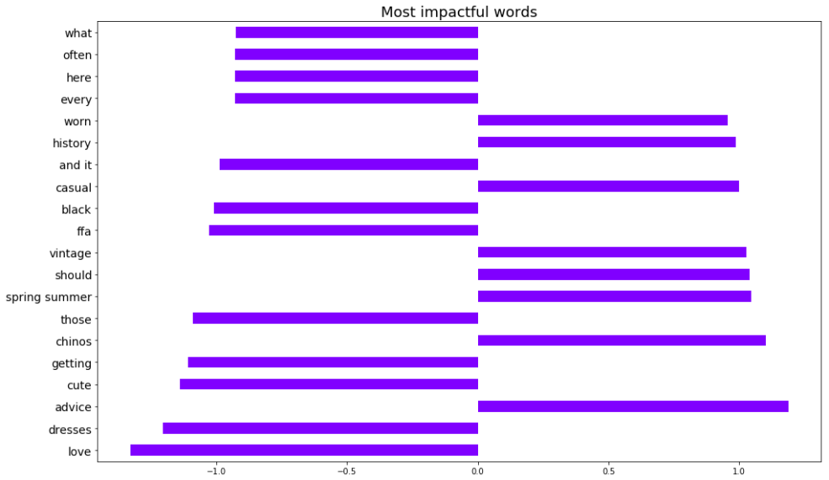

Slide 11
Conclusions
Base model
0.5
First model
0.75
Model
0.99
Substantial differences:
Phrases and words
Language architecture

Slide 12
Thank you!

